Slide 1
CS 288 Intensive Programming in Linux
Professor Ding, Xiaoning
This content may NOT be uploaded, shared, or distributed, as it is protected.

Slide 2
Structures and pointers

Slide 3
Structures can organize data in different types
Declared using struct with member types and names included in braces.
struct variables can be declared with the struct.
struct transaction
{
int id;
float amount;
char name[20];
char addr[30];
} t, *pt;
struct transaction
{
int id;
float amount;
char name[20];
char addr[30];
};
struct transaction t, *pt;
typedef struct
{
int id;
float amount;
char name[20];
char addr[30];
} transaction;
transaction t,*pt;
Notes:
Instructor:
Often multiple variables must be passed from one function to another, and often these variables have different data types. Thus it is useful to have a container to store various types of variables in. Structs allow the programmer to do just that.

Slide 4
Accessing struct members using . or ->
A member in a struct variable can be access using .
A member in a struct pointed by a pointer can be access using -> or by dereferencing the pointer first and then using .
pt=&t;
printf("id: %d, name: %s, addr: %s",
t.id, pt->name, (*pt).addr);

Slide 5
Pointer members in a struct
Some members need to have their memory dynamically allocated or location dynamically determined.
Extra pointers can be added to structs to support data structures, e.g., linked list, stack, queue, tree, graph, …
struct transaction{
int id;
float amount;
char name[20];
char *addr;
} t1, t2;
t1.addr=(char *)malloc(30);
t2.addr=&another_str;
struct transaction{
int id;
float amount;
char name[20];
char *addr;
struct transaction *next;
} t1, t2;
t1->next = &t2;

Slide 6
Linked Lists
A linked list is a sequence of connected nodes.
Each node contains at least
Some data
A pointer to the next node in the list
The head pointer points to the first node
The last node points to NULL
The tail pointer (optional) points to the last node.
node * a;
…
'\0'
a->next = b;
b->next = c;
z->next = NULL;
node * head;
node * tail;

Slide 7
Why linked list?
Often the maximum size of the list cannot be estimated.
Static arrays have fixed sizes.
Extending dynamic arrays (malloc-ed mem space) may need to copy data from the old and smaller space to a larger new space.
Usually there are updates in the middle of the list, e.g., insertion, deletion, re-arranging, etc. Overhead is high with arrays.
Inserting a new element in the front or deleting the first element requires shifting all the elements in the array
On average, half of the lists needs to be moved for insertion/deletion.
Compared to an array, linked list uses only as much space as is needed (requires extra-space for pointers)

Slide 8
Building a linked list
Declare node type --- self-referential struct
Create nodes --- allocate memory on-demand, initialize members
Link nodes to the list --- find a location on the list (the previous and/or the next node) and update pointers in these nodes and the new node.
Keep the head pointer updated --- If the address is lost, the whole list may be lost.
Ensure the next pointer of the last node to NULL.
If there is a tail pointer, keep it updated
node * a;
node * b;
…
'\0'
a->next = b;
b->next = c;
z->next = NULL;
node * head;
node * tail;

Slide 9
#include <stdio.h>
#include <stdlib.h>
struct node{
int id;
char name[20];
struct node *next;
};
int main(){
struct node *head=NULL, *tail=NULL, *pnode;
while(1){
pnode=(struct node *)malloc(sizeof(struct node));
printf("id:"); scanf("%d", &(pnode->id));
if(pnode->id<0) break;
printf("name:"); scanf("%s", pnode->name);
pnode->next=NULL; /*ensure next pointer of last node is NULL */
if(head==NULL) head=pnode;
if(tail!=NULL) tail->next=pnode;
tail=pnode;
}
Declare node type self_referential struct
head/tail pointers always point to the first/last node.
Create and initialize a new node
Link the new node to the end

Slide 10
Traverse a linked list
pnode=head;
while(pnode!=NULL) {
printf("id: %d\t name:%s\n", pnode->id, pnode->name);
pnode=pnode->next;
}
}
Start from the head pointer.
Proceed following the next pointers of nodes.
Stop when the last node is reached.
Last node: next pointer is NULL, or pointed by the tail pointer.

Slide 11
Adding a node to a list
adding to the front
node * head;
'\0'
?
node * b;
b->next = head;
head = b;
Order of the operations is important
head = b;
b->next = ?

Slide 12
Adding a node to a list
adding to the front
Inserting into the middle
node * a;
node * head;
'\0'
?
'\0'
node * b;
node * b;
b->next = head;
head = b;
b->next = a->next;
a->next = b;
Order of the operations is important
head = b;
b->next = ?
Consider a->next as a "head pointer" to the rest of the list.

Slide 13
Deleting a node
a->next;
a->next->next;
node * a;
p
p = a->next;
a->next = a->next->next;
…
free(p);

Slide 14
Deleting the first node
a->next;
a->next->next;
node * a;
p = head;
head = head->next;
…
free(p);
p
p = a->next;
a->next = a->next->next;
…
free(p);
Deleting the last node
?

Slide 15
Inserting/deleting a node: what to notice?
Check whether the node is to be added to (deleted from) the front, the middle, or the end of the list.
Different operations for different locations.
Avoid losing the pointer pointing to a node
It becomes ``inaccessible'' if there are no pointers points to it.
Keep the head pointer and the tail poiner (if you have one) updated.

Slide 16
Other types of linked list
struct node{
int id;
char name[20];
struct node *next;
struct node *prev;
};
Double linked list
node * a;
node * b;
node * z;
a->next = b;
b->next = c;
…
'\0'
'\0'
node * head;
a->prev = NULL;
b->prev = a;
z->next = NULL;
node * tail;
Circular linked list
To be covered in data structure courses, including other data structures, such as trees and graphs.
node * a;
node * b;
…
a->next = b;
b->next = c;
z->next = a;
node * head;
node * tail;

Slide 17
State space search and A* search

Slide 18
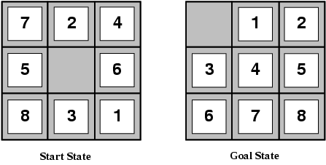
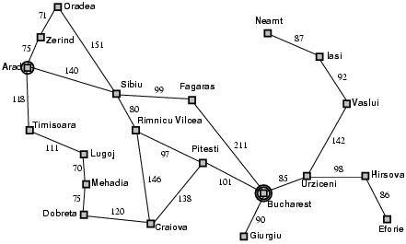

Solving problems by searching
The solution is a fixed sequence of actions
Search is the process of looking for the sequence of actions that reaches the goal
Start state
Goal state

Slide 19
Components in a search problem
Initial state
Initial state
Actions
Transition model
What is the result of performing
a given action in a given state?
Goal state
Path cost
Assume that it is a sum of nonnegative step costs
The optimal solution is the sequence of actions that gives the lowest path cost for reaching the goal
Search algorithms: how do we find high quality solutions?
Goal state

Slide 20
Example: path finding
Find a path from Arad to Bucharest
Initial state : Arad
Actions: Go from one city to another
Transition model: If you go from city A to city B, you end up in city B
Goal state: Bucharest
Path cost : Sum of distances

Slide 21
Example: the 8-puzzle
States: Locations of tiles
8-puzzle: 181,440 states
15-puzzle: 1.3 trillion states
24-puzzle: 10²⁵ states
Optimal solution of n-Puzzle is NP-hard
Transition model
The movement of the empty tile.
Actions
Move empty tile left, right, up, down
Path cost
1 per move

Slide 22
Other real-world examples
Routing
Touring
VLSI layout
Assembly sequencing
Protein design

Slide 23
What does a search algorithm do?
Begin at the initial state and expand it by making a list of all possible successor states
Maintain a fringe or a list of unchecked and unexpanded states
At each step, select a state from the fringe to check and expand
Selection is important: search strategy.
Determines quality of the solution.
Determines overhead (execution time and memory space used to find a solution).
Keep going until you reach the goal state or fringe is empty.

Slide 24
Search algorithm outline
Initialize the fringe using the initial state
While the fringe is not empty
Choose a fringe node according to search strategy and remove it from fringe
Check and expand the node
If the node contains the goal state, return solution
Otherwise, expand the node and add its children to the fringe
key data structure: fringe

Slide 25
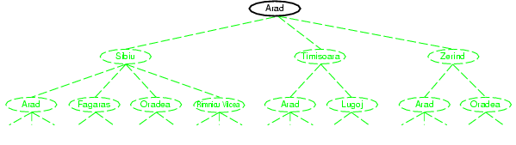
A search example

Slide 26
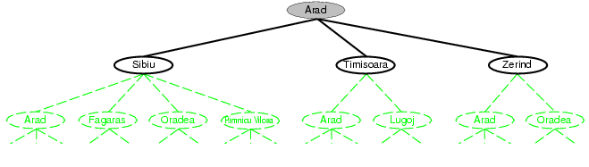
A search example

Slide 27
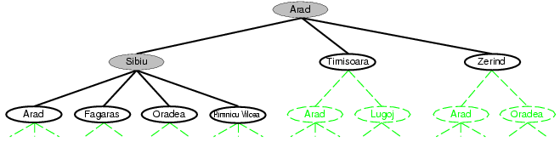
A search example
Fringe

Slide 28
Search tree for understanding and designing search algorithms
All the states in search are on a search tree
“What if” tree of possible actions and outcomes
Root node corresponds to starting state
Children of a node correspond to it successors states
Edges corresponds to actions
A solution is a path starting from root and ending in a goal state
There may be multiple goal states. But the search
can end when any one is reached.
Starting state
Action
Successor state
…
…
…
…
Goal state
Note: Implementation doesn’t need to actually build the tree structure.

Slide 29
Uninformed and informed search strategies
Uninformed strategies consider all stats are equally desirable.
use only the information available in the problem definition.
Breadth-first search
Depth-first search
Iterative deepening search
Informed strategies give the algorithm “hints” about the desirability of different states
Use an evaluation function to rank nodes and select the most promising one for expansion
Greedy best-first search
A* search

Slide 30
Breadth-first search
Expand shallowest unexpanded node
Non-recursive implementation:
fringe is a FIFO queue, i.e., new successors go at end
A
B
C
D
E
F
G

Slide 31
Breadth-first search
Expand shallowest unexpanded node
Non-recursive implementation:
fringe is a FIFO queue, i.e., new successors go at end
A
B
C
D
E
F
G

Slide 32
Breadth-first search
Expand shallowest unexpanded node
Non-recursive implementation:
fringe is a FIFO queue, i.e., new successors go at end
A
B
C
D
E
F
G

Slide 33
Breadth-first search
Expand shallowest unexpanded node
Non-recursive implementation:
fringe is a FIFO queue, i.e., new successors go at end
A
B
C
D
E
F
G

Slide 34
Breadth-first search
Expand shallowest unexpanded node
Non-recursive implementation:
fringe is a FIFO queue, i.e., new successors go at end
A
B
C
D
E
F
G

Slide 35
Pseudo-code for BFS
Generate an initially empty queue and call it OPEN.
OPEN is the fringe.
2. Insert the start state into OPEN.
3. Dequeue a state n from OPEN. If dequeue fails because OPEN is empty, search fails (END).
4. If n is a goal state, the search succeeds (END).
5. Generate all successors to n and enqueue them into OPEN (end of OPEN).
6. Destroy node n
7. Return to step 3.
Nodes are structures that organize states. Each node contains all the information associated to a state (e.g., state itself, cost, and pointers to link it to the fringe, etc).

Slide 36
Depth-first search
Expand deepest unexpanded node
Implementation:
fringe = LIFO queue, i.e., put successors at front
A
B
C
D
E
F
G

Slide 37
Depth-first search
Expand deepest unexpanded node
Implementation:
fringe = LIFO queue, i.e., put successors at front
A
B
C
D
E
F
G

Slide 38
Depth-first search
Expand deepest unexpanded node
Implementation:
fringe = LIFO queue, i.e., put successors at front
A
B
C
D
E
F
G

Slide 39
Depth-first search
Expand deepest unexpanded node
Implementation:
fringe = LIFO queue, i.e., put successors at front
A
B
C
D
E
F
G

Slide 40
Depth-first search
Expand deepest unexpanded node
Implementation:
fringe = LIFO queue, i.e., put successors at front
A
B
C
D
E
F
G

Slide 41
Depth-first search
Expand deepest unexpanded node
Implementation:
fringe = LIFO queue, i.e., put successors at front
A
B
C
D
E
F
G

Slide 42
Depth-first search
Expand deepest unexpanded node
Implementation:
fringe = LIFO queue, i.e., put successors at front
A
B
C
D
E
F
G

Slide 43
Depth-first search
Expand deepest unexpanded node
Implementation:
fringe = LIFO queue, i.e., put successors at front
A
B
C
D
E
F
G

Slide 44
Depth-first search
Expand deepest unexpanded node
Implementation:
fringe = LIFO queue, i.e., put successors at front
A
B
C
D
E
F
G

Slide 45
Pseudo-code for DFS
1. Generate an initially empty stack and call it OPEN.
2. Insert the start state into OPEN.
3. Pop a state n from OPEN. If pop fails because OPEN is empty, search fails (END).
4. If n is a goal state, the search succeeds (END).
5. Generate all successors to n and push them onto OPEN (beginning of OPEN).
6. Destroy node n.
7. Return to step 3.

Slide 46
BFS vs DFS
BFS
can always find the best solution (shortest path)
Use a lot of memory
DFS
Returns the first solution it finds. May not find the best solution
Use less memory than BFS
may fail in infinite-depth paths (e.g., moving a tile back and forth)
Can be modified to avoid repeated states along paths
complete in finite spaces, but increase memory consumption

Slide 47
DFS with CLOSED list
1. Generate an initially empty stack and call it OPEN, and a list called CLOSED.
2. Insert the start state into OPEN.
3. Pop a state n from OPEN. If pop fails because OPEN is empty, search fails (END).
4. If n is a goal state, the search succeeds (END).
5. Generate all successors to n.
6. Remove the successors that are already in OPEN or CLOSED list
7. Push the remaining successors onto OPEN (beginning of OPEN).
8. Add n into CLOSED list
9. Return to step 3.

Slide 48
Informed search
Idea: give the algorithm “hints” about the desirability of different states
Use an evaluation function to rank nodes and select the most promising one for expansion
Greedy best-first search
A* search

Slide 49
Heuristic function
Heuristic function h(n) estimates the cost of reaching goal from node n
Example:
Start state
Goal state

Slide 50
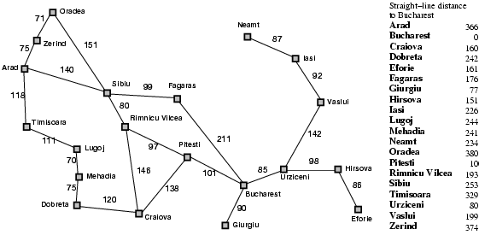
Heuristic for the path finding problem

Slide 51
Greedy best-first search
Expand the node that has the lowest value of the heuristic function h(n)

Slide 52

Greedy best-first search example

Slide 53
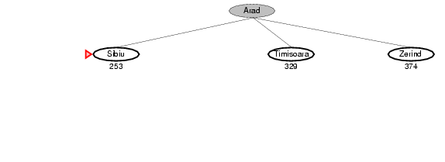
Greedy best-first search example

Slide 54
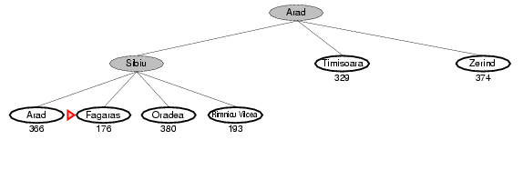
Greedy best-first search example

Slide 55
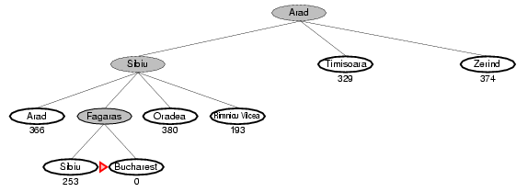
Greedy best-first search example

Slide 56
Greedy best-first search may get stuck in loops
start
goal

Slide 57
Greedy best-first search is not optimal

Slide 58
A* search
Idea: avoid expanding paths that are already expensive
The evaluation function f(n) is the estimated total cost of the path through node n to the goal:
f(n) = g(n) + h(n)
g(n): cost so far to reach n (path cost)
h(n): estimated cost from n to goal (heuristic)

Slide 59

A* search example

Slide 60
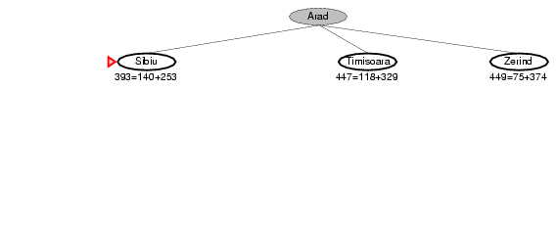
A* search example

Slide 61
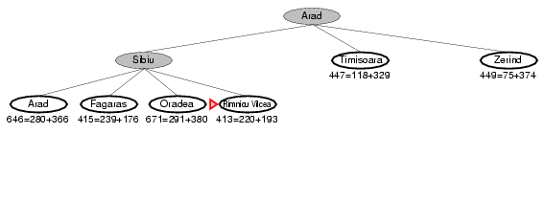
A* search example

Slide 62
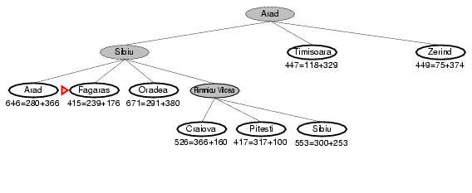
A* search example

Slide 63
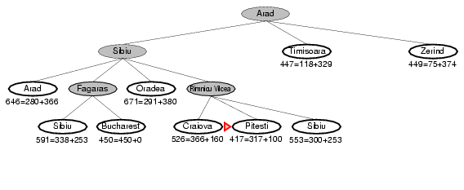
A* search example

Slide 64
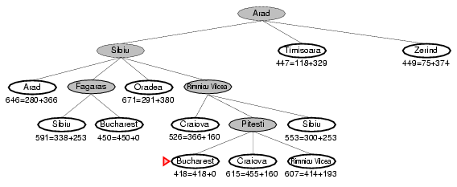
A* search example

Slide 65
Pseudo-code for A*
1. Generate an initially empty priority queue and call it OPEN, prioritized by f(n) value.
2. Generate an initially empty collection of states and call it CLOSED.
3. Insert the start state (or states) into OPEN.
4. Remove the state with smallest f(n) value (state n) from OPEN. If removal fails because OPEN is empty, search fails (END).
5. If n is a goal state, finish the search.
6. Generate all successors to n;
7. Remove and free the successors that are already in OPEN or CLOSED list.
8. Push remaining successors onto OPEN (prioritized by f(n) value).
9. Add n to CLOSED.
10. Return to step 4.

Slide 66
Admissible heuristics
A heuristic h(n) is admissible if for every node n, h(n) ≤ h*(n), where h*(n) is the true cost to reach the goal state from n
An admissible heuristic never overestimates the cost to reach the goal, i.e., it is optimistic
Example: straight line distance never overestimates the actual road distance
Theorem: If h(n) is admissible, A* is optimal

Slide 67
Designing heuristic functions
Heuristics for the 8-puzzle
h₁(n) = number of misplaced tiles
h₂(n) = total Manhattan distance (number of squares from desired location of each tile)
h₁(start) = 8
h₂(start) = 3+1+2+2+2+3+3+2 = 18
Are h₁ and h₂ admissible?
State being evaluated Goal State

Slide 68
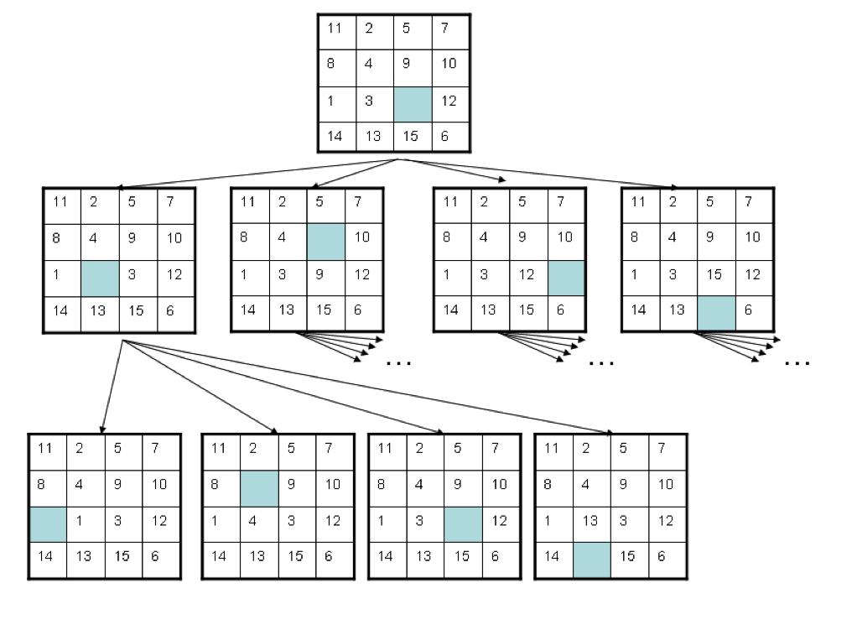
15-puzzle problem

